Slide 1

Citizen Complaint
Batch-B7
Name of the students: Name of the guide:
T.Sravanisai(154G1A0586) K.Varun Kumar Reddy,
M.Ruhia (154G1A0573) M.Tech., Assistant Professor
K.Vamshi (154G1A0599)
K.Jithin (154G1A05B3)
Srinivasa Ramanujan Institute of Technology
Department of Computer Science & Engineering

Slide 2
Abstract
The idea of this system is to help citizens to register complaints about daily problems in their ward using mobile application.
The application will provide interface to a common man to deliver his complaint and problem to municipal authority and let the authorities of municipal to address the problem early as possible.
This application provides interface to register or lodge complaints .
One of the key features is the provision for citizens to lodge complaints using their mobile phones with a software android application mainly designed to lodge complaints.

Slide 3
Contents
Introduction
Problem Definition
Existing system
Literature survey
Limitations
Proposed System
Implementation
Output screens
Modules
References

Slide 4
Introduction
The day to day operations and functioning of the city is taken care by local governing bodies which are known as Government Authorities. Among many other things one of the most important responsibility of the Government Authorities is to manage and solve the complaints that the residents of the city might have.
The main purpose of this project is to help the public in knowing their place details and getting their problems solved in online without going to the officer regularly until the problem is solved. By this system the public can save his time.

Slide 5
Problem Definition
This application will allow the citizens to send the complaints directly from their smart phone and enable the citizens of city to lodge complaints anytime, anywhere.

Slide 6
Existing system
By calling a contact centre, where the complaint is registered by a call centre agent by typing the complaint into electronic form.
By filling in online complaint registration form i.e. through web portal.

Slide 7
Literature survey
Through web portal:
The web portal while allowing the users to lodge complaint has some serious constrains.
Limitations:
The user is restricted to choose from among the list of predefined drop down list. This poses a major problem in the sense that the user tries to fit his complaint intone of the predefined drop downs. This results in a wrong fit and the complaint being directed to the wrong department which in turn affects the time taken to resolve the problem.
The second major constraint is the need for the user to be aware of the ward number, additionally the user needs to have access to networked computer.

Slide 8
Continued..
Prajavani:
Prajavani is an e-governance initiative by the combined efforts of District administration and National Informatics center in Ranga Reddy. Prajavani is a unique public private partnership program, which gives citizens an opportunity to interact with government without coming to any government office.
Limitations:
No registration facility is provided and can post the problems directly.
Users can post their problems but cannot get the details regarding progress of their complaint.

Slide 9
Proposed System
In the proposed system the citizen need not go to the government office for getting his problem solved. The proposed system will enable the citizens of city to lodge complaints anytime, anywhere.
The users use the mobile phone and do not need to access the web portal interface directly to file their complaint. The user runs the Application and can lodge complaint.

Slide 10
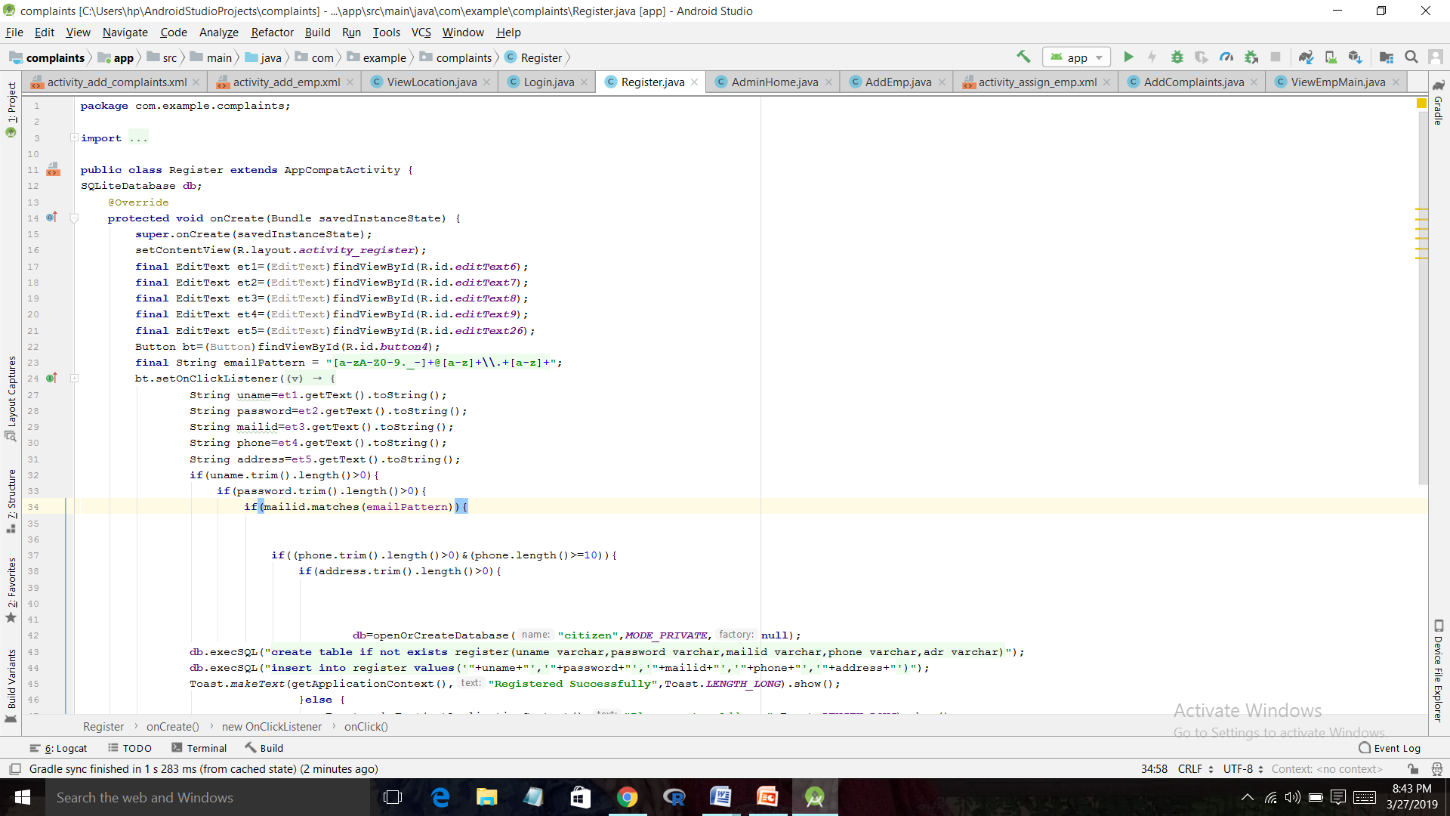
Implementation

Slide 11
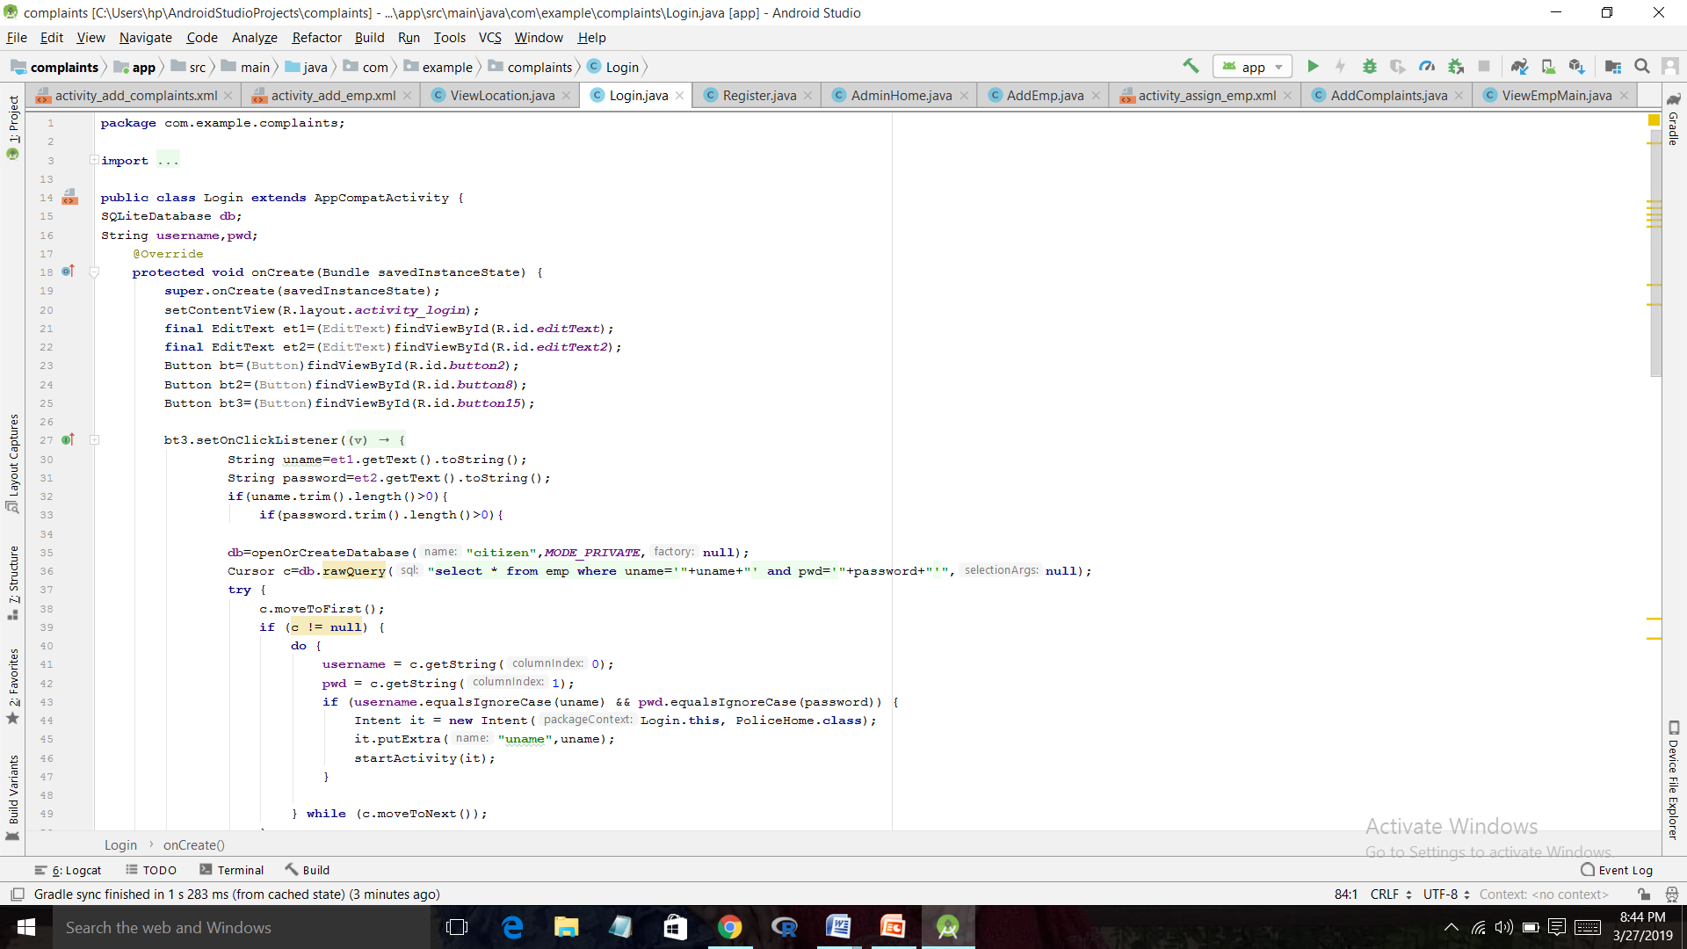
Continue…
Code for login

Slide 12
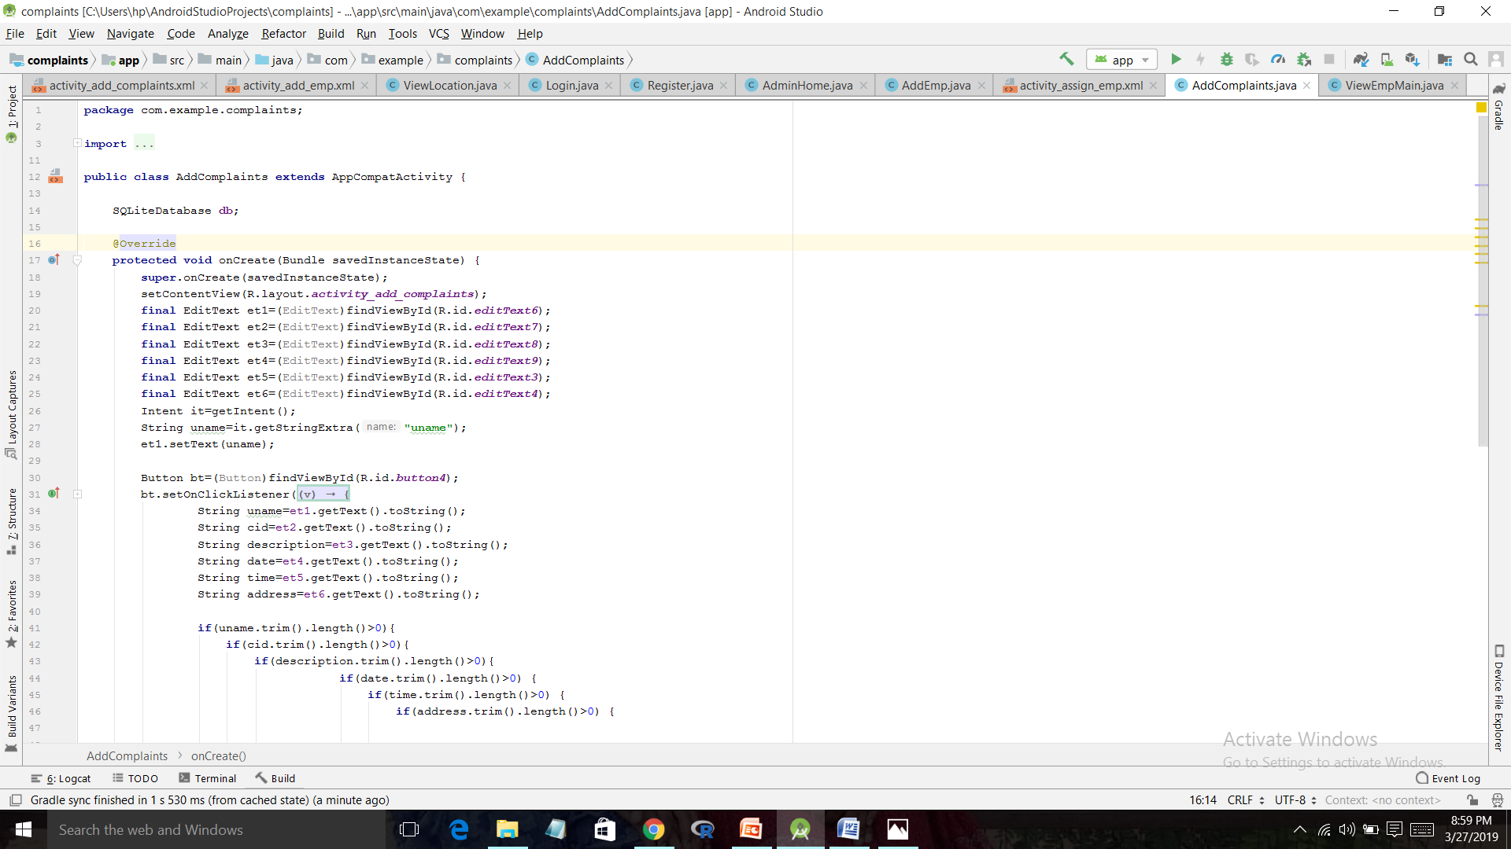
Continue…
Code for add complaints

Slide 13
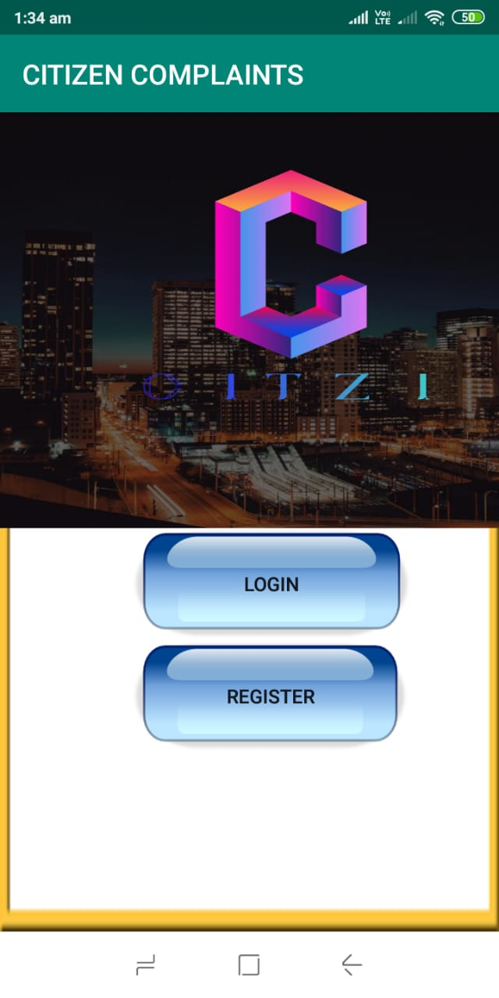
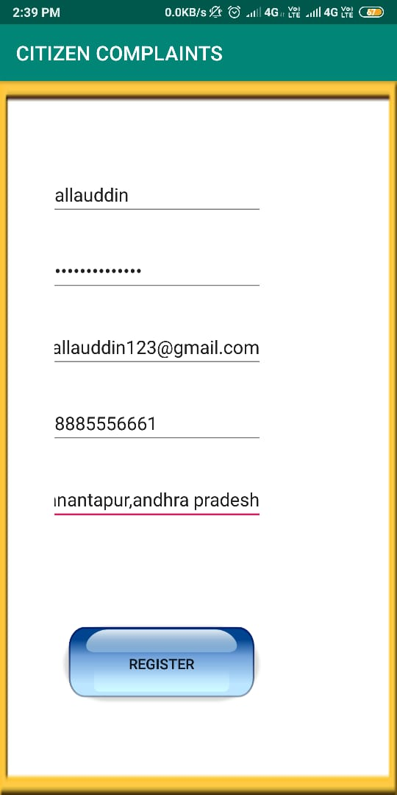
Output screens

Slide 14
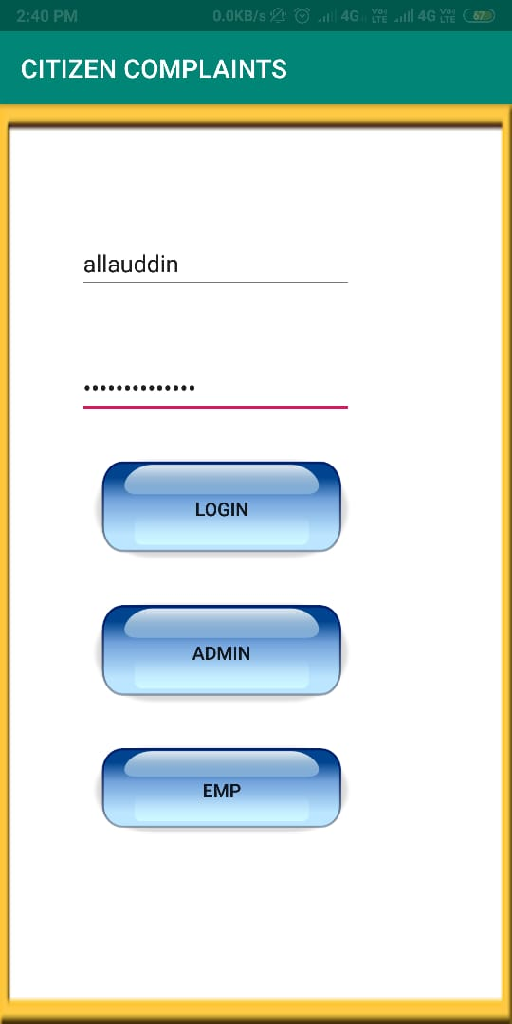
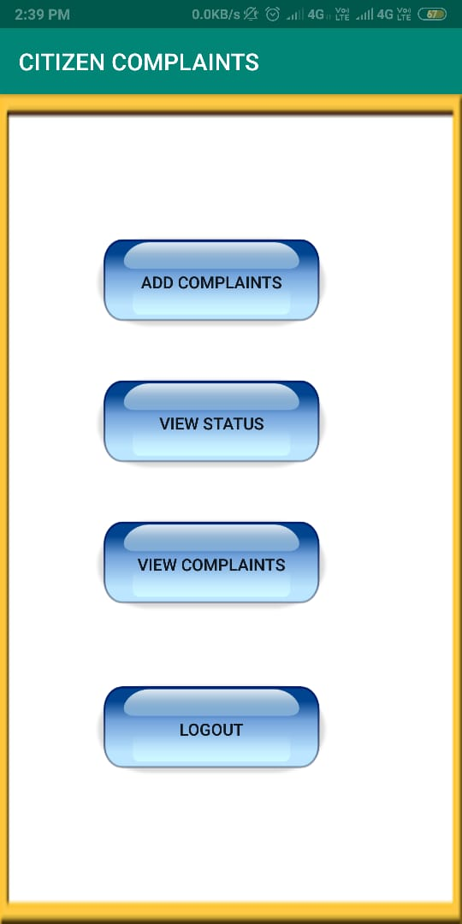
Continued..

Slide 15
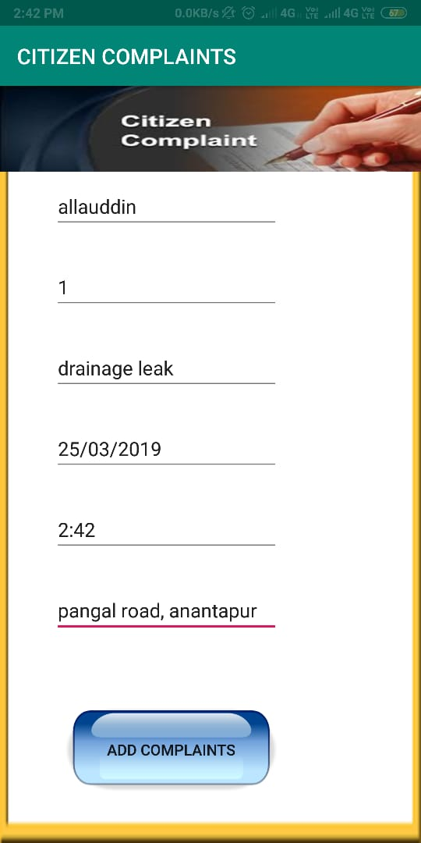

Slide 16
Modules
User:
Login his/her account
Lodge compliant
Get Status
Admin:
Add employee
View complaints
View citizens
Assign employee
Employee:
Login
View Complaints

Slide 17
Requirements:
Tools Used:
Android studio
Hardware Requirements:
RAM-4GB
Hard Disk -1GB
Technology:
Java
Extensible Mark up Language(XML)

Slide 18
References:
[1] Trupti Bomble and Ritika Raut, “Android Based Complaint Management System for Municipal Corporation”, Int. Journal of Engineering Research and Applications., Volume-5,Issue 4,pp.64-66,April 2015.
[2] Gausar Gawde and Sharvil Sartare, “Mobile Application for Resolving Citizen Complaints”, ISARCET., Volume 5, Issue 3, March-2016.

Slide 19
Thank you
Queries
?

